Slide 1


CSE445 · SECTION 7 · PROJECT GROUP 3
SnapClass: AI-Powered Dual-Modality Classroom Attendance
Real-Time Face & Voice Biometric Verification with Human-in-the-Loop Confirmation
Tirtho Mojumdar
Ramisa Anjum
Md Rakibul Hasan
Hafsa Amin Ela
2312536042
2232552642
2212346042
2131884642
SnapClass Attendance System
Slide 01

Slide 2












01 | THE PROBLEM
"Can a standard camera & microphone reliably verify attendance — without losing human oversight?"
Roll Call Wastes Time
Proxy Attendance
Unverified Records
Calling out names aloud consumes 5–10 minutes of every single class period, taking away valuable teaching time from instructors.
Traditional roll calls, paper sign-in sheets, and simple passcode apps make it trivial for students to answer or sign on behalf of absent peers.
Existing digital solutions fail to verify whether the student answering the call is physically present inside the lecture room.
Group 3| Tirtho Mojumdar · Ramisa Anjum · Md Rakibul Hasan · Hafsa Amin Ela
Slide 02

Slide 3





02 | OUR APPROACH
Combining dual biometric recognition pipelines with instructor control for fraud-proof attendance tracking.
Face Recognition
Captures classroom frame via webcam to identify student facial features using high-precision 128-dimensional vector embeddings.
Analyzes speech audio snippets as an active secondary biometric to verify student presence in dynamic environment conditions.
Voice Recognition
Human Confirmation
Presents instant AI suggestions to the instructor with visual/audio evidence before committing any record permanently to the DB.
Group 3| Tirtho Mojumdar · Ramisa Anjum · Md Rakibul Hasan · Hafsa Amin Ela
Slide 03

Slide 4

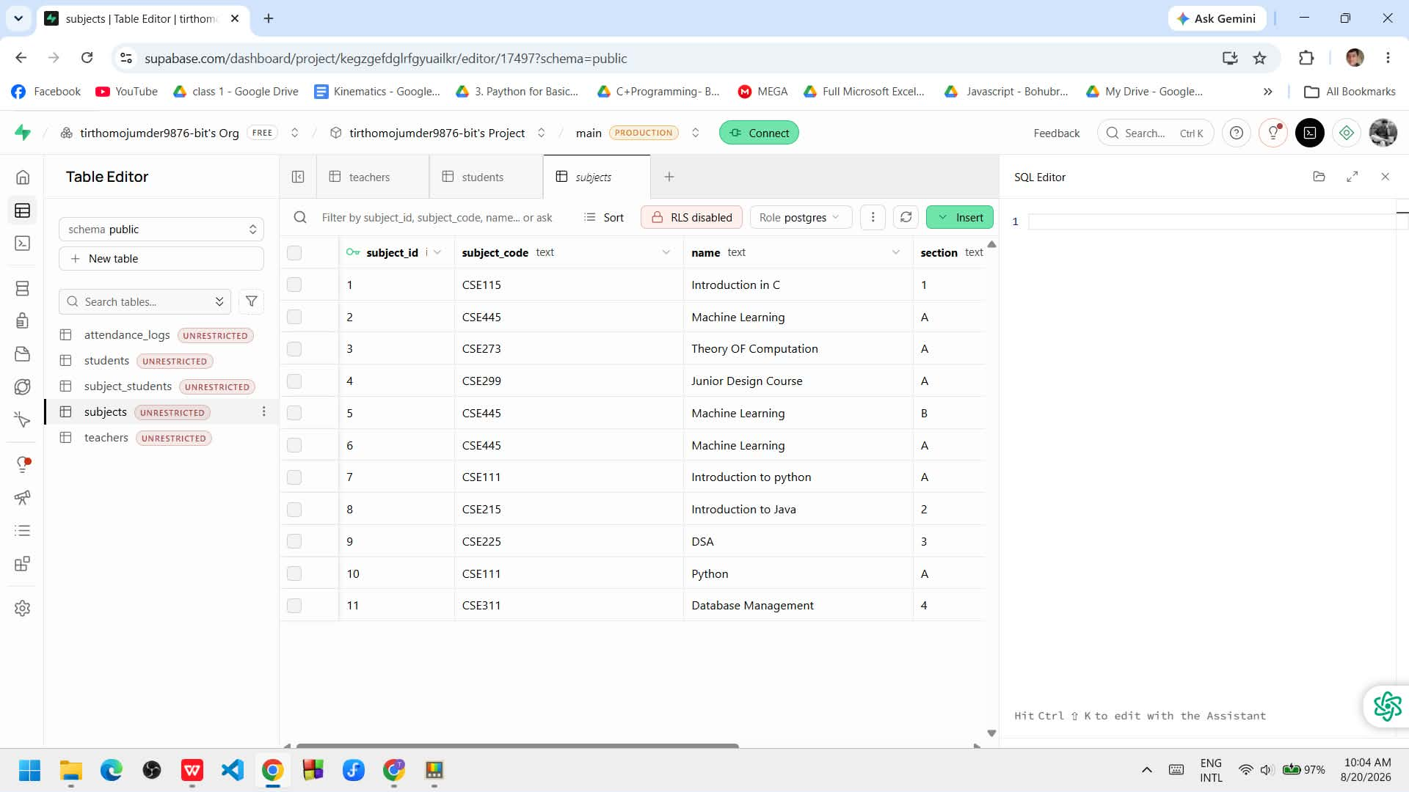

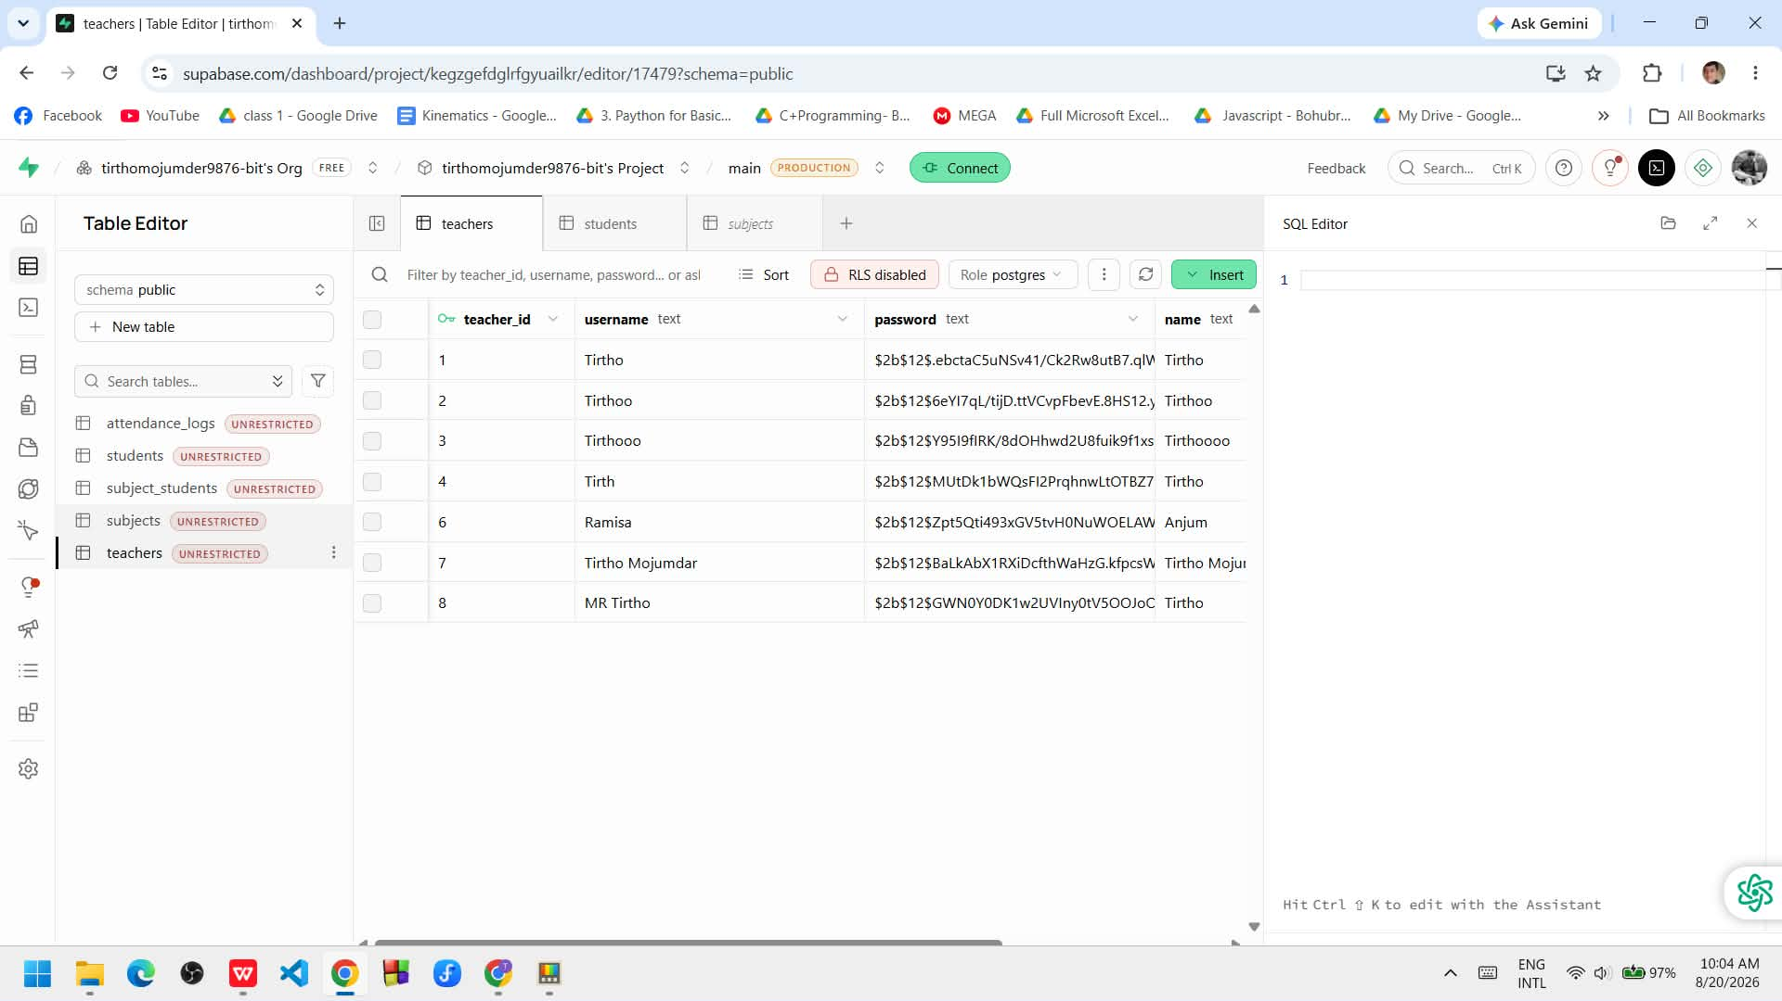
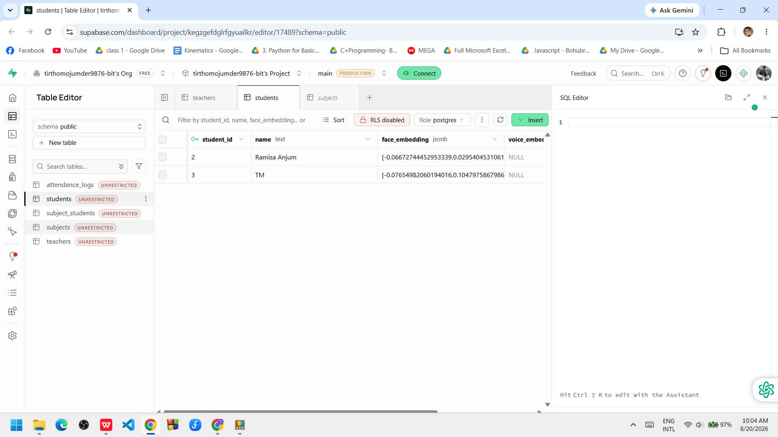
03 | SYSTEM ARCHITECTURE
Webcam & Mic Input: Streamlit frontend captures real-time video snapshot & voice wave.
Feature Extractor: Python backend calculates Euclidean distance between embeddings.
Matching Engine: Compares live vectors against stored Supabase student profiles.
Database Persistence: Teacher confirmation writes attendance log directly to SQL table using Supabase.
Group 3| Tirtho Mojumdar · Ramisa Anjum · Md Rakibul Hasan · Hafsa Amin Ela
Slide 04

Slide 5

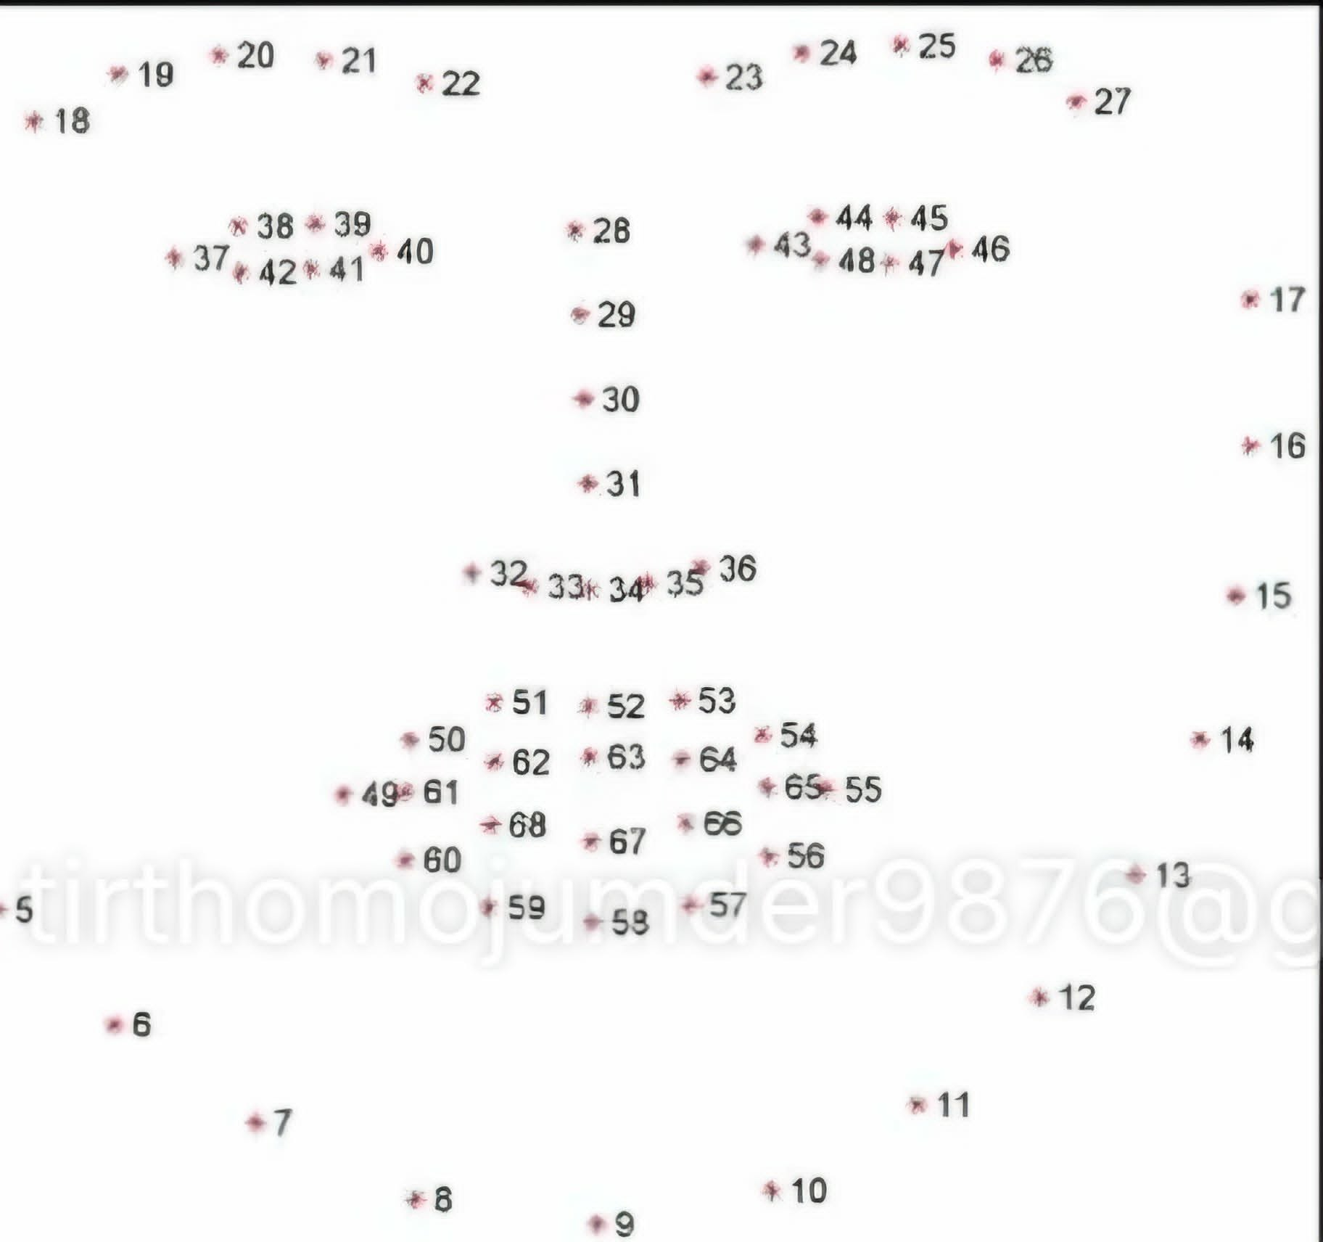
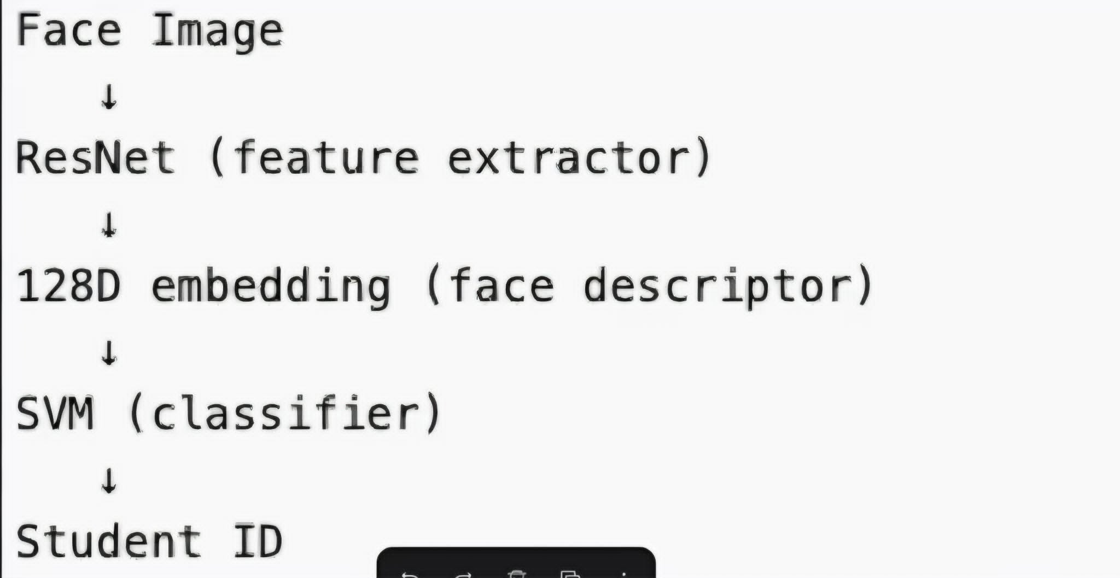
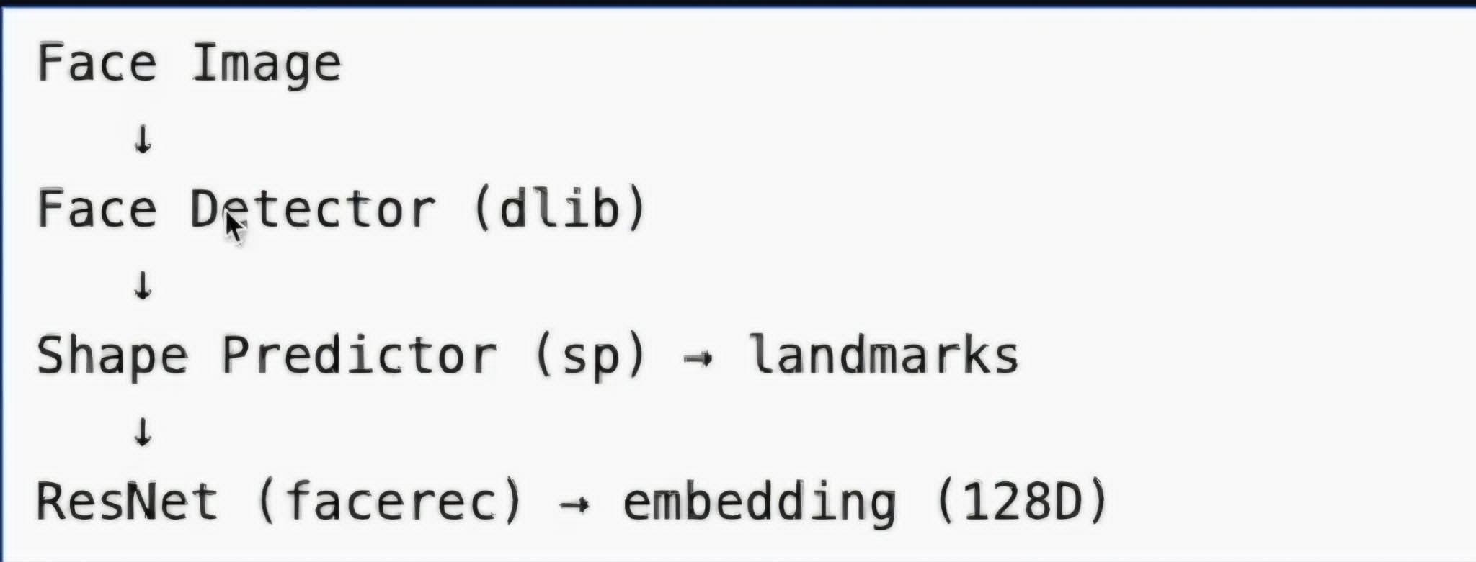
03 | BIOMETRIC FACE PIPELINE (PART 1)
68 landmarks locate eyes, nose, jaw & brows
Face → Detect → Landmarks → 128-D Embedding
The dlib finds the face, locates 68 landmark points to align it, then a ResNet turns the aligned face into a 128-number fingerprint — this is the same fingerprint for the same person, every time."
Group 3| Tirtho Mojumdar · Ramisa Anjum · Md Rakibul Hasan · Hafsa Amin Ela
Slide 05

Slide 6
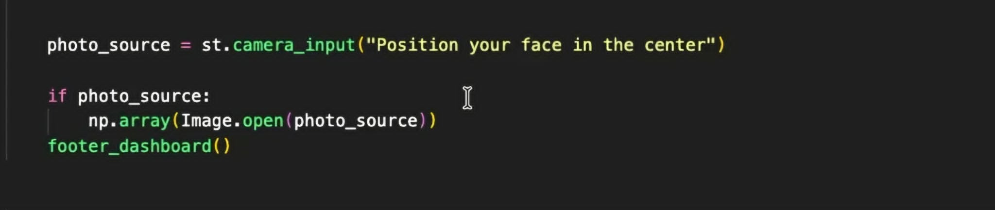
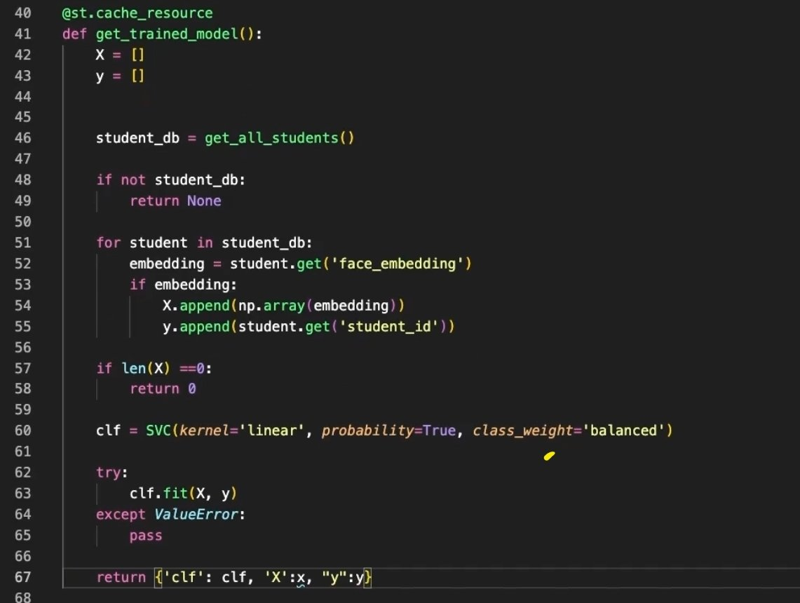
03 | BIOMETRIC FACE PIPELINE CODE (PART 2)
Classifier retrains on every enrolled student, live
Captured straight from the browser — no extra hardware
The 128 numbers go into a linear SVM trained on every enrolled student's fingerprint — that's get_trained_mdel() right here, retrained fresh every time someone new registers. And the actual capture is one line: st.camera_input, right from the student's own webcam.
Group 3| Tirtho Mojumdar · Ramisa Anjum · Md Rakibul Hasan · Hafsa Amin Ela
Slide 06

Slide 7
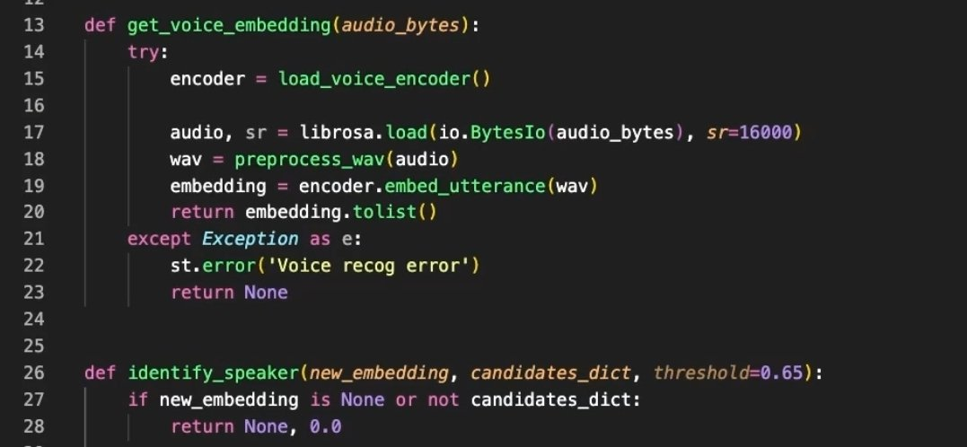
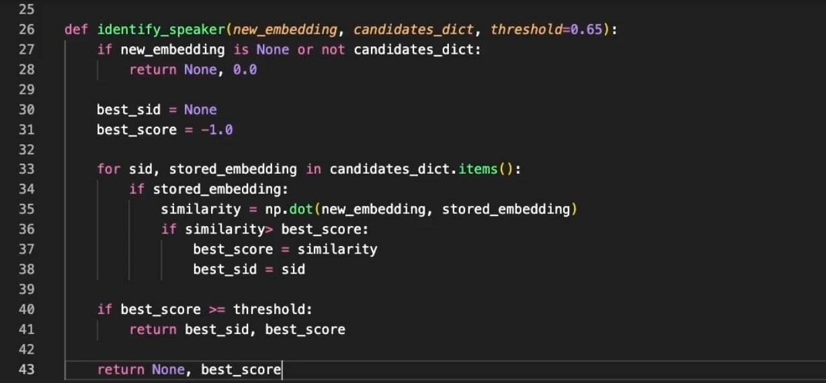
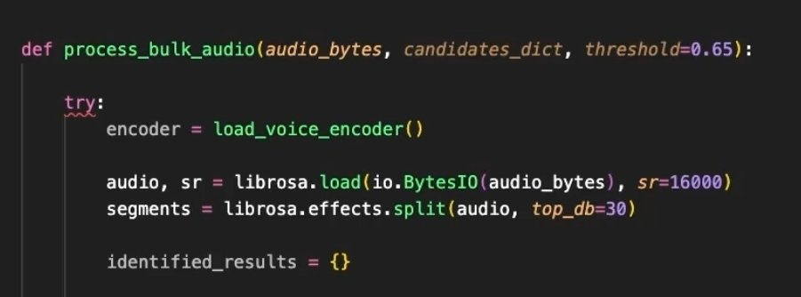
03 | BIOMETRIC VOICE PIPELINE
Voice clip → Resemblyzer → speaker embedding
librosa.effects.split() cuts one recording into who's-speaking segments
Same idea as face matching: compare fingerprints, and only trust a confident match.
Voice mirrors the face pipeline exactly. librosa splits the recording into segments where someone's actually talking — silence gets thrown out. Each segment becomes an embedding via get_voice_embedding, and identify_speaker compares it against every enrolled student's stored voice using np.dot — that's cosine similarity, since these embeddings are pre-normalized. Score has to clear 0.65 or it's rejected, same conservative philosophy as the face side.
Group 3| Tirtho Mojumdar · Ramisa Anjum · Md Rakibul Hasan · Hafsa Amin Ela
Slide 07

Slide 8

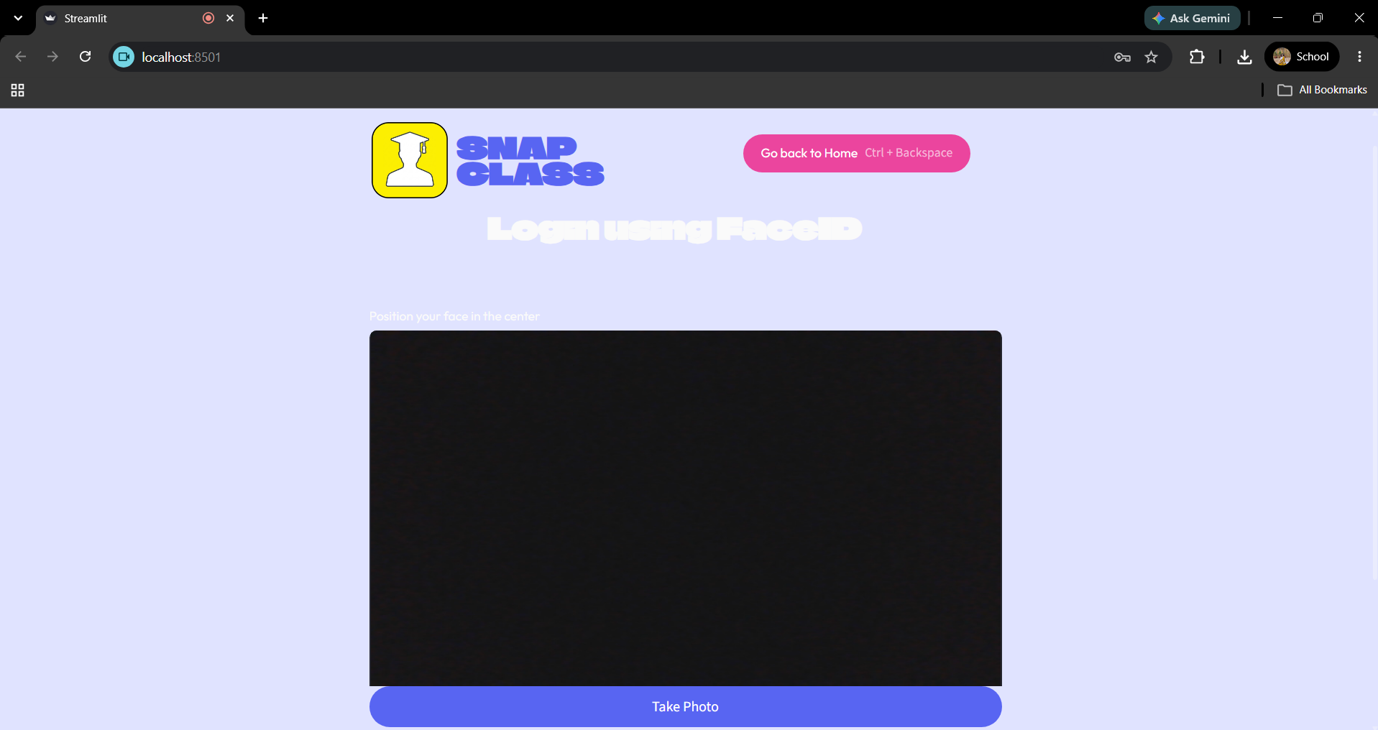
05 | STUDENT PORTAL (Part 1)
Registration Workflow
How a student creates an account and sets up biometrics:
Webcam Capture: Student provides clear face image sample via browser webcam.
Voice Recording: Student reads sample phrase to generate voice embedding.
Profile Saved: System computes embeddings and saves metadata to DB.
Student Login via Webcam and Voice
Failure Handling: If a student attempts to login without completing face/voice registration, authentication fails with a warning to register first.
Group 3| Tirtho Mojumdar · Ramisa Anjum · Md Rakibul Hasan · Hafsa Amin Ela
Slide 08

Slide 9

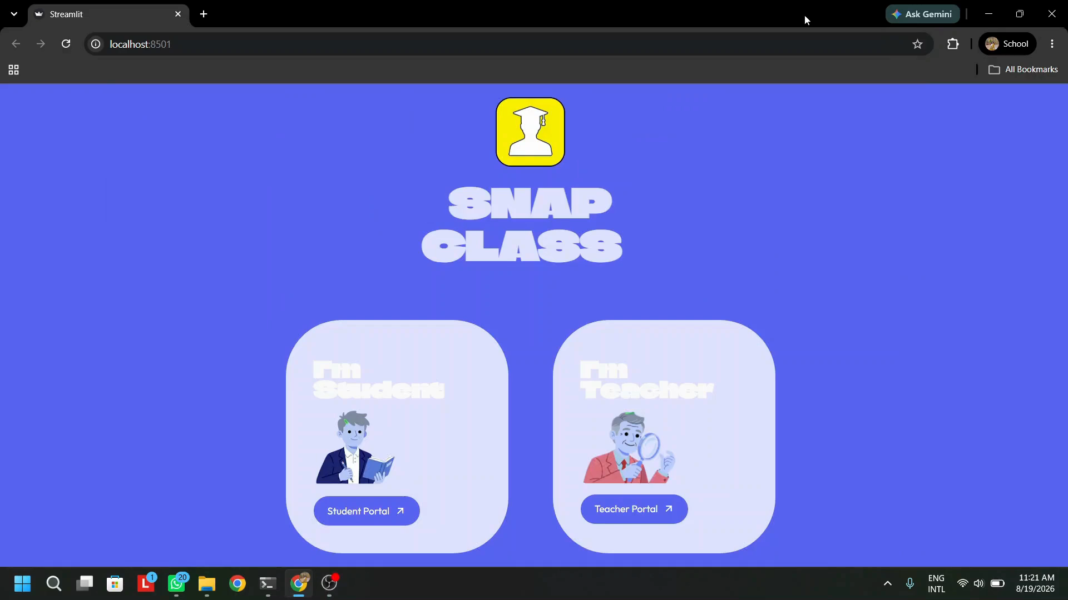
06 | STUDENT PORTAL (Part 2)
Course Enrollment Workflow
Browse Courses: Registered students view
available courses created by instructors.
Quick Enroll: Enrolls in the active section
(e.g., CSE445 Sec 7).
One-Click Unenroll: Unenrolls from
any course in one click.
Entire Student Login Workflow
Group 3| Tirtho Mojumdar · Ramisa Anjum · Md Rakibul Hasan · Hafsa Amin Ela
Slide 09

Slide 10

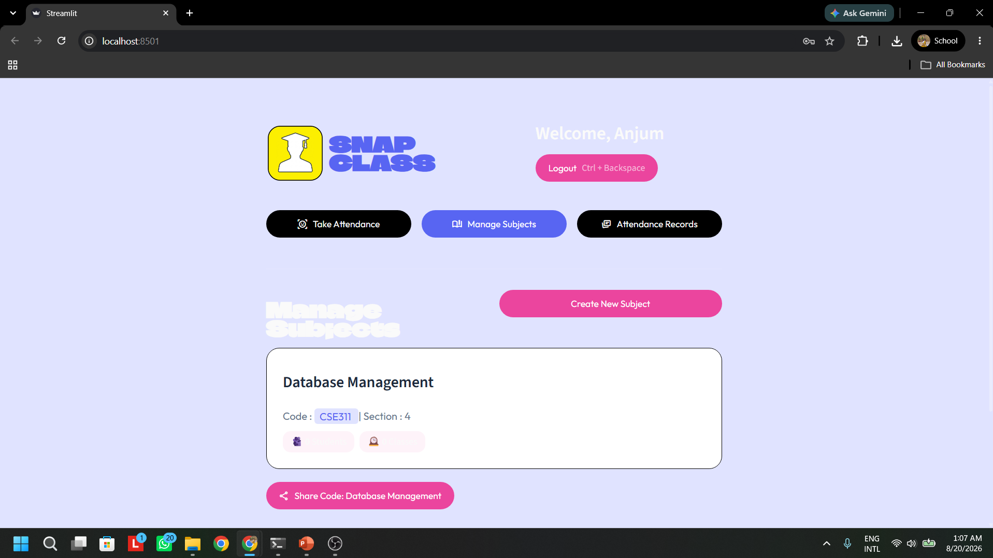
07 | TEACHER PORTAL (Part 1)
Onboarding & Creation
Instructor Setup: Teacher registers
username and passwords
Secure Login: Authenticates instructor
credentials to unlock class controls.
Create Courses: Instructor adds new
course codes, section titles, and student.
Course Creation & Class Control Dashboard
Group 3| Tirtho Mojumdar · Ramisa Anjum · Md Rakibul Hasan · Hafsa Amin Ela
Slide 10

Slide 11

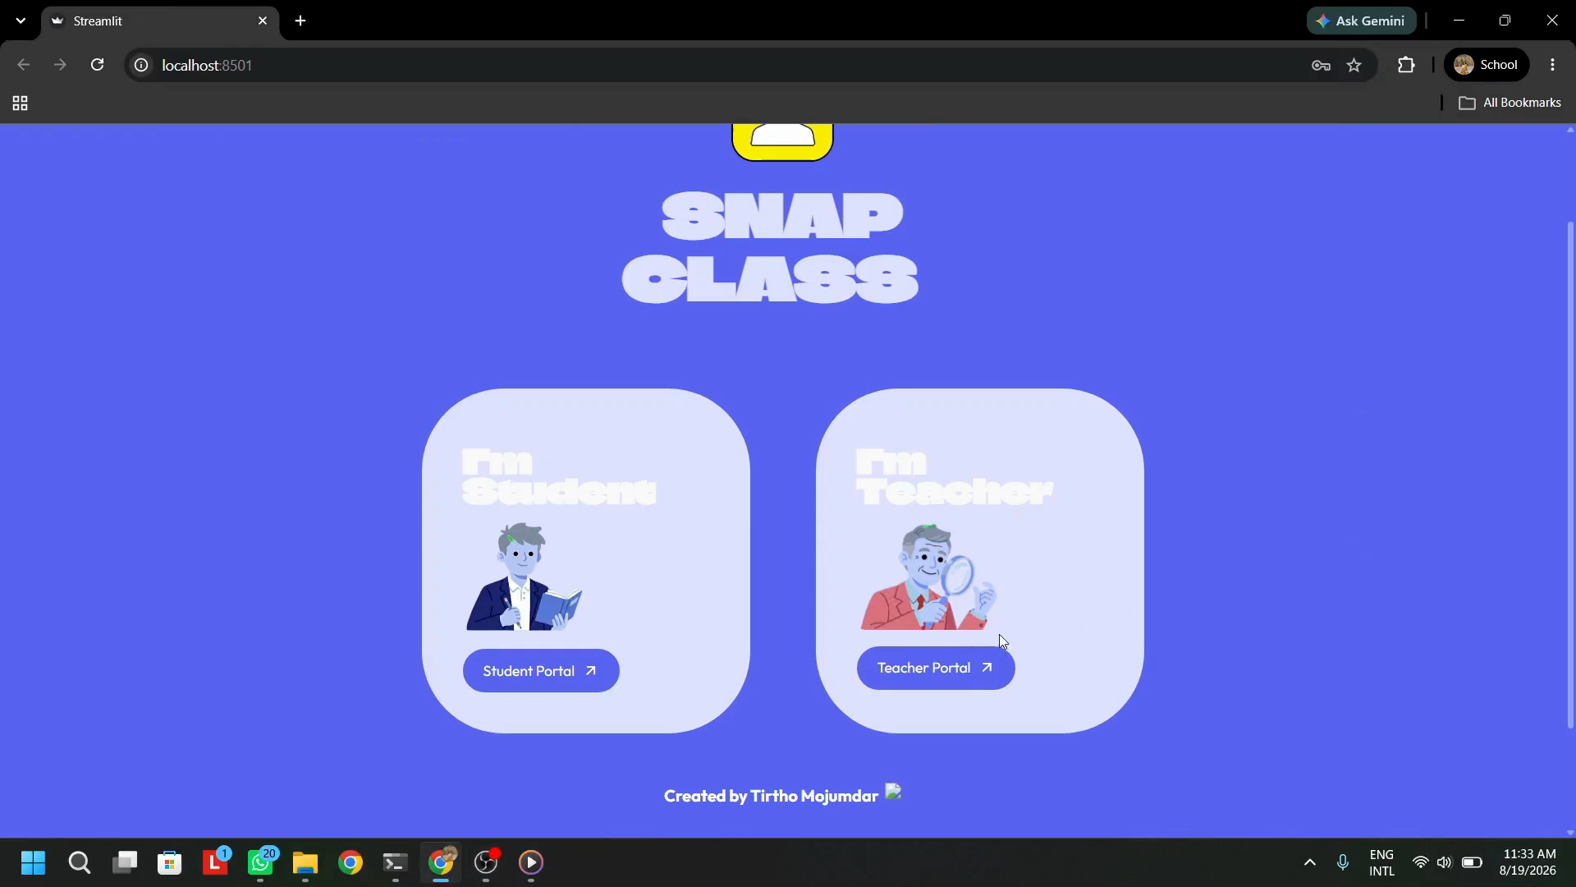
08 | TEACHER PORTAL (PART 2)
Live Attendance Process
Select Course: Teacher chooses active course
section from dashboard.
Webcam Snap: Opens live webcam feed &
captures image when student appears.
Face Analysis: Runs instant AI vector
matching against database profiles.
Voice Check: Prompts secondary voice
check for verification.
Entire Teacher Workflow
Confirmation: Confirmation pop-up shows
matched student details & saves to DB.
Group 3| Tirtho Mojumdar · Ramisa Anjum · Md Rakibul Hasan · Hafsa Amin Ela
Slide 11

Slide 12



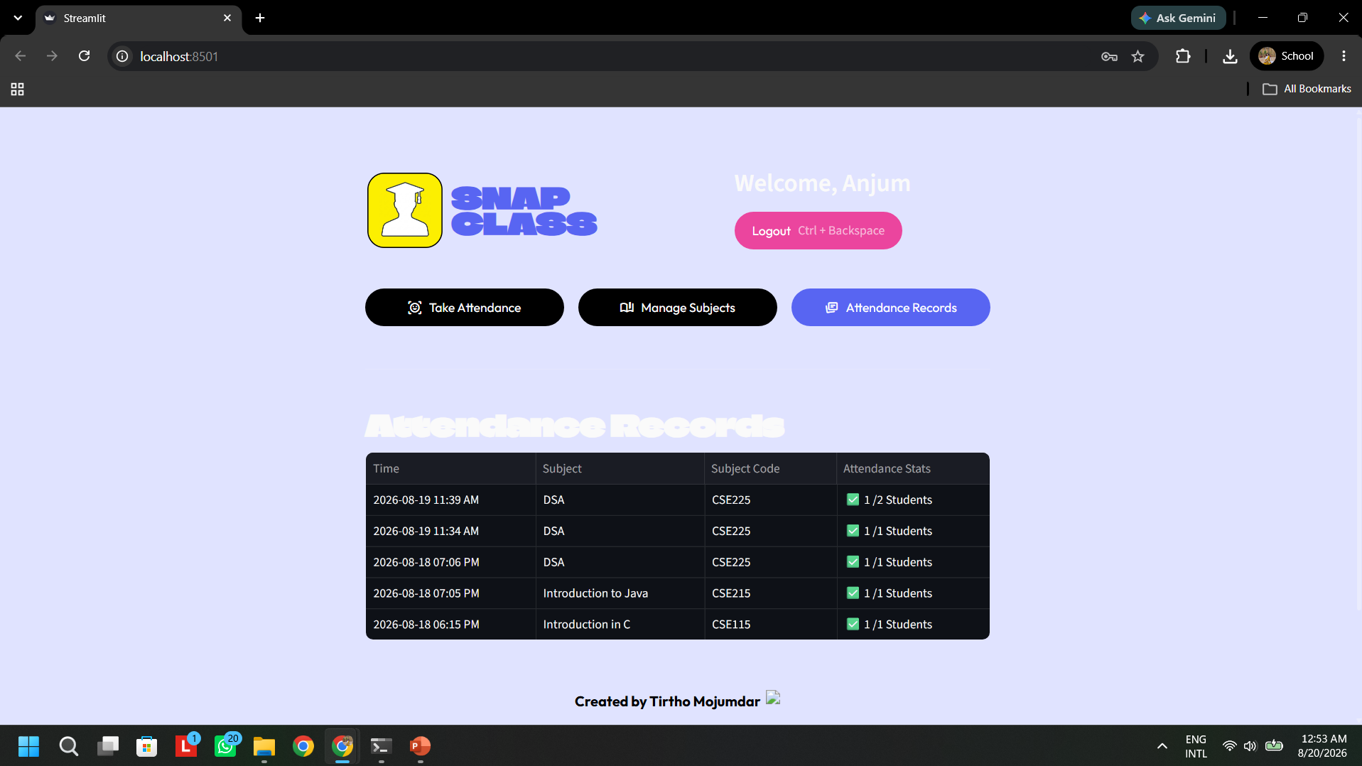
09 | HUMAN IN THE LOOP (TEACHER CONFIRMATION)
Nothing reaches a student's permanent record without the instructor tapping "Confirm & Save".
1. AI Match
2. Evidence Shown
3. Teacher Reviews
4. Confirm & Save
Detects face/voice
Displays photo/audio
Verifies visual/audio
Pushed to Database
Full Evidence Transparency
Teacher can view all the attendence records of the students for each course along with the timestamp.
Teacher Attendance Record
Group 3| Tirtho Mojumdar · Ramisa Anjum · Md Rakibul Hasan · Hafsa Amin Ela
Slide 12

Slide 13



10 | EVALUATION & FINDINGS
What Worked Well
Worth Improving
Reliably rejected un-enrolled persons outside the active roster.
Single-photo enrollment had lower accuracy under extreme lighting/angles.
Voice ID matched consistently in quiet/moderate classroom environments.
Voice matching accuracy degraded in noisy ambient backgrounds.
Fast workflow: full review-and-confirm cycle completed in under 1 minute.
Requires full large-scale benchmarking across full-size lecture halls.
Group 3| Tirtho Mojumdar · Ramisa Anjum · Md Rakibul Hasan · Hafsa Amin Ela
Slide 13

Slide 14




11 | FUTURE ROADMAP
QR Code Scanning
Multi-Sample Profiles
Empirical Benchmarking
Implement QR code scanning for instant sharing to enroll in the courses for the students.
Average multiple face photos and voice samples per student during onboarding to boost angle resilience and accuracy.
Conduct formal large-scale classroom benchmarking to publish precision, recall, and processing speed metrics.
Group 3| Tirtho Mojumdar · Ramisa Anjum · Md Rakibul Hasan · Hafsa Amin Ela
Slide 14

Slide 15

12 | Live System Demo
Interactive Walkthrough: Student Onboarding, Teacher Course Creation & Dual-Modality Attendance
Group 3| Tirtho Mojumdar · Ramisa Anjum · Md Rakibul Hasan · Hafsa Amin Ela
Slide 15

Slide 16


CSE445 · SECTION 7 · PROJECT GROUP 3
Thank You!
GITHUB REPOSITORY
github.com/tirthomojumder9876-bit/Inteligent-Al-Attendence
SnapClass AI Attendance Presentation
Slide 16

